Slide 1
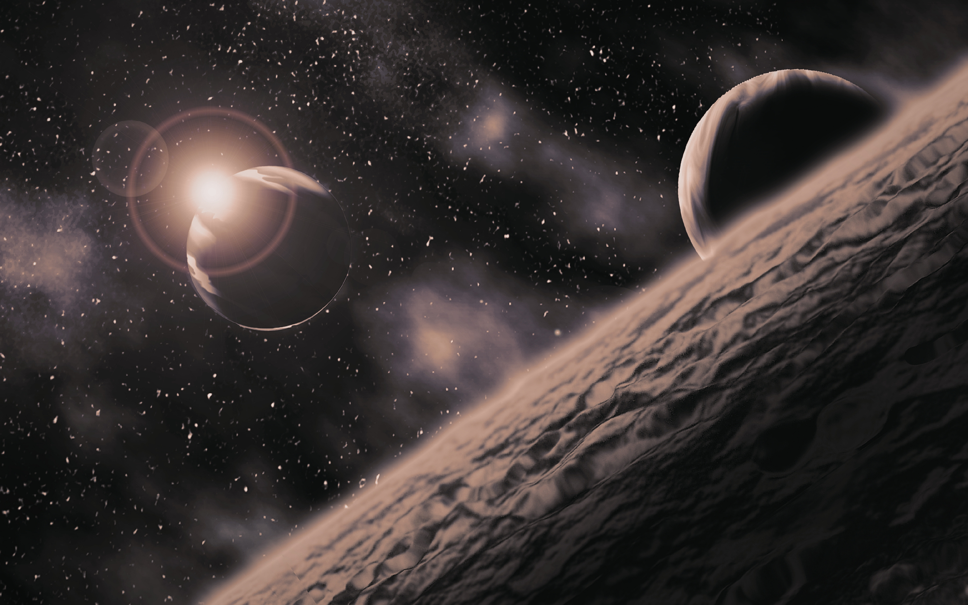
Exoplanets Discoveries and Detection Bias
Programming for Data Science Assessment
Dataset : NASA Exoplanet Archive
Notes:
Explain the focus is not about finding new planets but detection bias

Slide 2

Dataset Overview
Source : NASA Exoplanet Archive (PSCompPars Table)
5,690 confirmed exoplanets after cleaning
Research Question: Do planets discovered via the Transit method have different radii than those discovered via Radial Velocity?
Key variables used:
Discovery method – categorises planets by detection technique
Discovery year – captures temporal trends in detections
Orbital period – indicates planet–star separation and detection bias
Planet radius – primary variable used to compare discovery methods
Planet mass – provides additional physical context for detected planets
Host star temperature – characterises stellar environments of detected planets
Notes:
Explain briefly what exoplanets are
Explain dataset was cleaned to keep entries that were complete in info

Slide 3
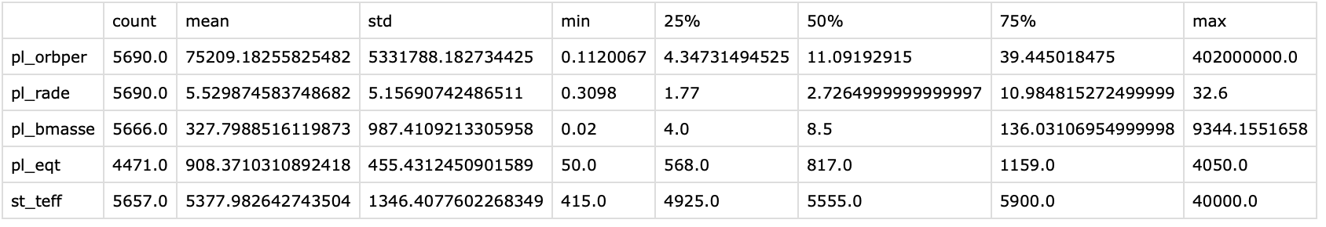
Summary Statistics
Orbital period (days)
Median: 11.1, Mean: 75,209, IQR: 4.3 - 39.4
Extreme right skew with values up to 4.02 × 10⁸ days
This indicates strong detection bias toward short period planets
Planet radius (Earth radii)
Median: 2.73, Mean: 5.53, IQR: 0.31 - 10.98
Large gap between median and maximum shows overrepresentation of large planets
Planet mass (Earth masses)
Median: 8.5, Mean: 327.8, IQR: 4 - 136
The mass distribution is swayed and dominated by a small number of very massive and heavy planets
Equilibrium temperature (K)
Mean: 908, Median: 817 , IQR: 568–1,159
Temperatures skew toward hot planets which imply dominance of shorter period, close-in orbits
It also reflects detection bias, as hotter planets produce stronger transit and radial velocity signals
Host star temperature (K)
Median: 5,555 , IQR: 4,925–5,900
Most detected planets orbit Sun-like stars rather than very cool or very hot stars
This reflects where searches are concentrated and under what circumstances the planet signals are easiest to measure
Notes:
Explain how summary statistics show strong skewness that indicate the existance of detection bias especially for close-in and massive exoplanets

Slide 4
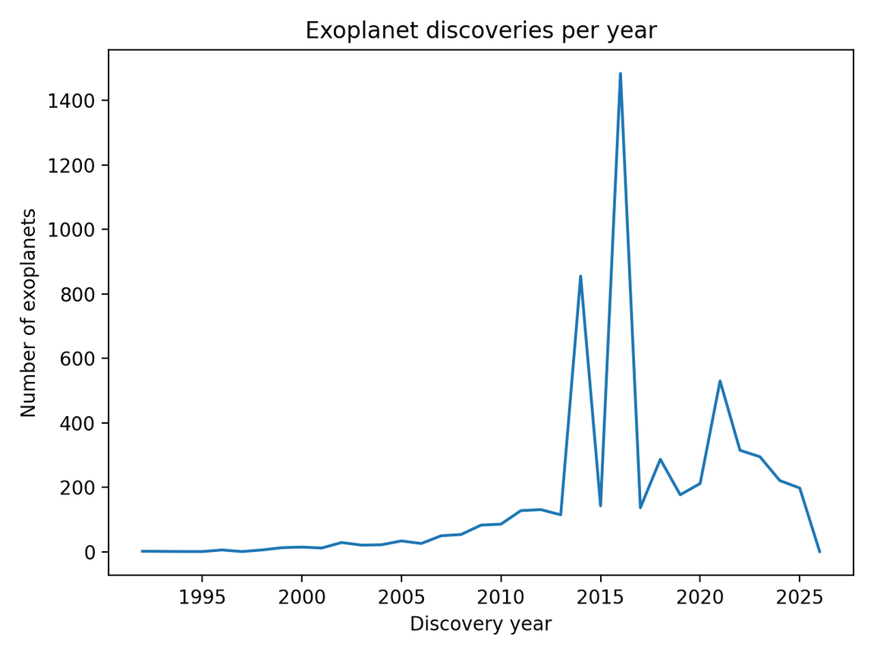
Discoveries over Time
We can see a increase in discoveries from the mid-1990s to late 2000s due to the launch of the Hubble Telescope
Sharp rise in detections between 2014 and 2017 due to the increase in Kepler Missions by NASA and again in 2021 due to the launch of the James Webb Telescope
Spikes reflect large batches of planet validated and confirmed together.
Trends represent observational activity rather than true planet formation rates
Notes:
Explain how the spikes relate to data processing timelines rather than actual surges in planet discoveries

Slide 5
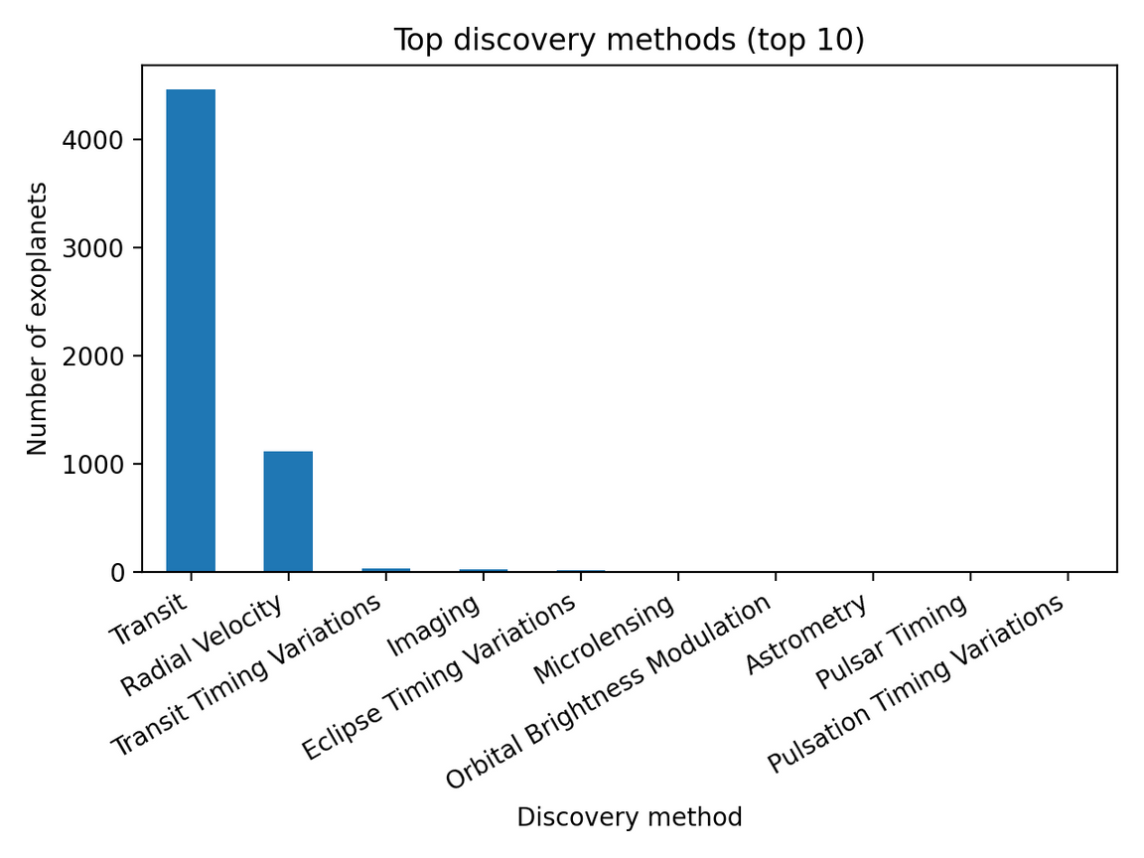
Dominant Discovery Methods
From the graph, Transit method dominates detections due to it:
Allowing monitoring of thousands of stars simultaneously
Being highly efficient at detecting planets that pass in front of their stars
Radial velocity is the second most common method as it:
Detects planets by measuring small movements of the host star
Particularly effective for identifying massive planets
Other methods contribute smaller samples
Often require specialised conditions or instruments
Typically detect a narrower range of planet types
Notes:
Explain that transit and radial velocity methods being dominant is not due to randomisation but rather these two being the most efficient and widely used methods due to its efficiency

Slide 6
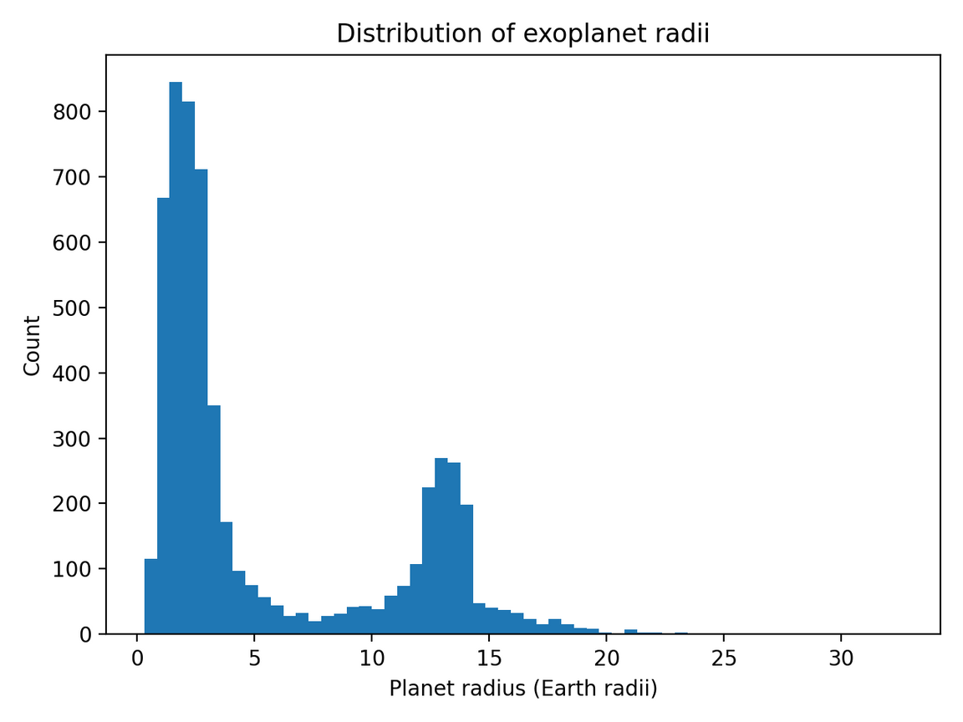
Distribution of Planet Radii
Strong right-skew in planet sizes
Most detected planets have relatively small radii
A small number of very large planets extend the upper tail
High concentration of planets below ~4 Earth radii
Indicates frequent detection of Earth-sized and super-Earth planets
Reflects improved sensitivity of modern transit surveys
Distinct population of large gas giants
Large planets are easier to detect due to stronger signals
Results in overrepresentation compared to their true occurrence
Notes:
Explain the long right tail of the distribution indicates that a small number of very large gas giants strongly influence the overall range even though most planets are much smaller

Slide 7
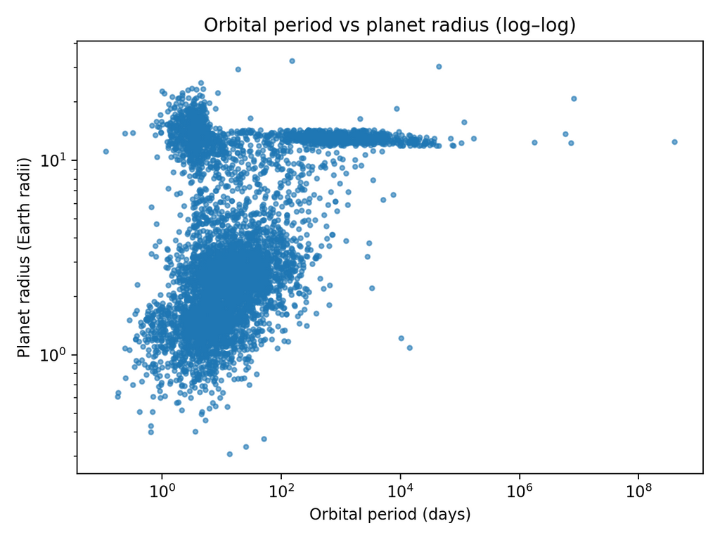
Orbital Period vs Planet Radius
Larger planets cluster at short orbital periods
Many detected large planets orbit very close to their stars
Close-in planets produce stronger, easier-to-detect signals
Small planets become rare at long orbital periods
Detection of small planets decreases rapidly as orbital period increases
Long period planets require long observation times and repeated measurements
Log–log scaling showcases a clear structure across wide ranges
Makes patterns visible throughout several orders of magnitude
Prevents shorter period planets from visually dominating the plot
Notes:
Explain that the absence of many small planets detected is due to a detection limitation and not the pure absence of these planets and that the clustering of large planets at short orbital periods reflects observational practicality as frequent transits and strong signals are easier to detect and confirm

Slide 8
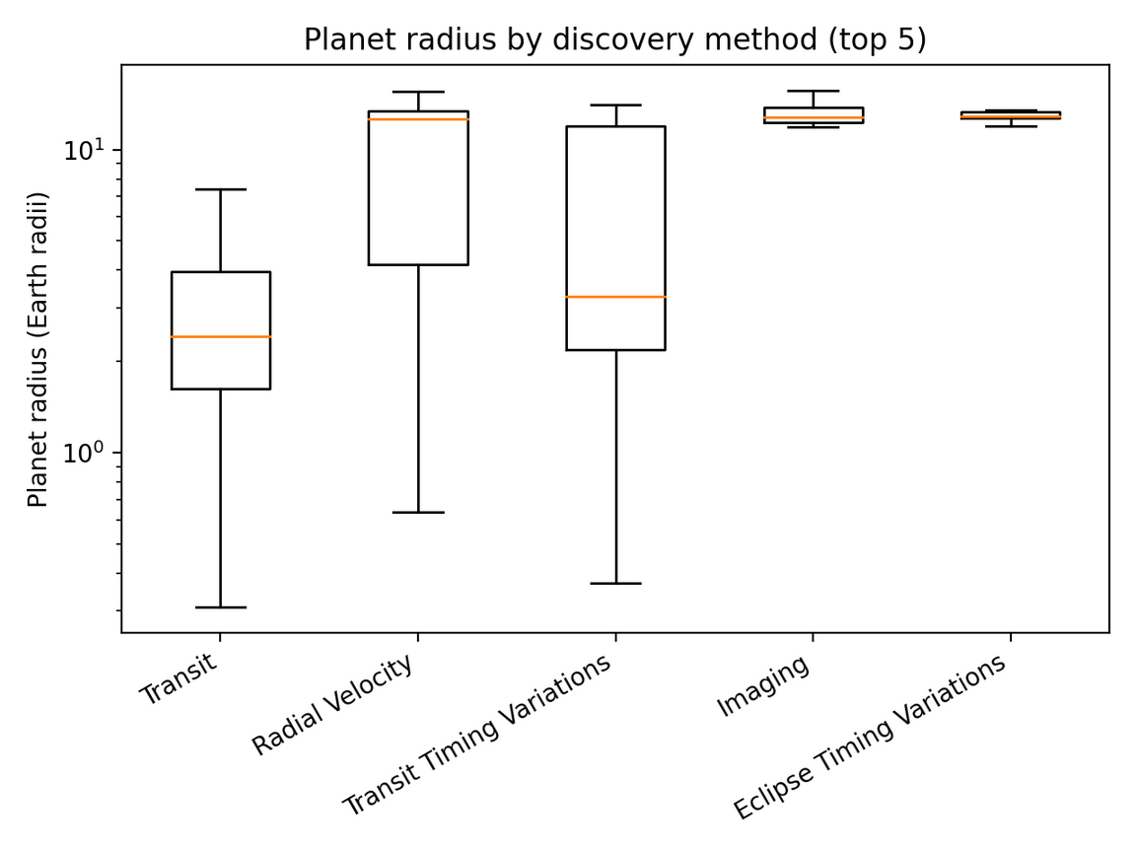
Planet Radius vs Discovery Method
Transit method detects smaller median planet radii
Includes a broad range of small and medium-sized planets
It is sensitive to shallow signals produced by smaller planets
Radial velocity detects larger planets on average
Median radius is higher than for transit detections
It is more effective at detecting planets that strongly influence their host stars
Visual differences are statistically confirmed
Mann–Whitney U test applied to radius distributions instead of t-test
p-value = 3.38 × 10⁻²⁰⁰, indicating a significant difference and we reject the null hypothesis
Notes:
-explain that the mann-whitney u test was used instead of a t-test as there was strong skewness and violation of normality assumptions which are necessary.

Slide 9
Conclusion and Challenges with the Code
Conclusion:
The analysis performed demonstrates that exoplanets that were discovered using the Transit method do have a significantly smaller radii on average when compared to the exoplanets discovered using the Radial Velocity method. This difference was statistically confirmed using the Mann-Whitney U test, which showed an extremely low p-value once again confirming that differences in exoplanet radii is driven by discovery methods rather than random occurrences.
Challenges:
While trying to authenticate myself, git threw an error in which password authentication is no longer supported. To fix this error I used a PAT (Personal Access Token) and configuring credential storage which was saved on the macOS Keychain
Notes:
- Explain that this result provides strong statistical evidence to reject the null hypothesis which inherently confirms that the observed difference in radii between transit and radial velocity discoveries is a systematic effect rather than random sampling variation and this is shown through the p-value
-Explain how github is moving to make users use PAT as opposed to passwords from 2026

Slide 10

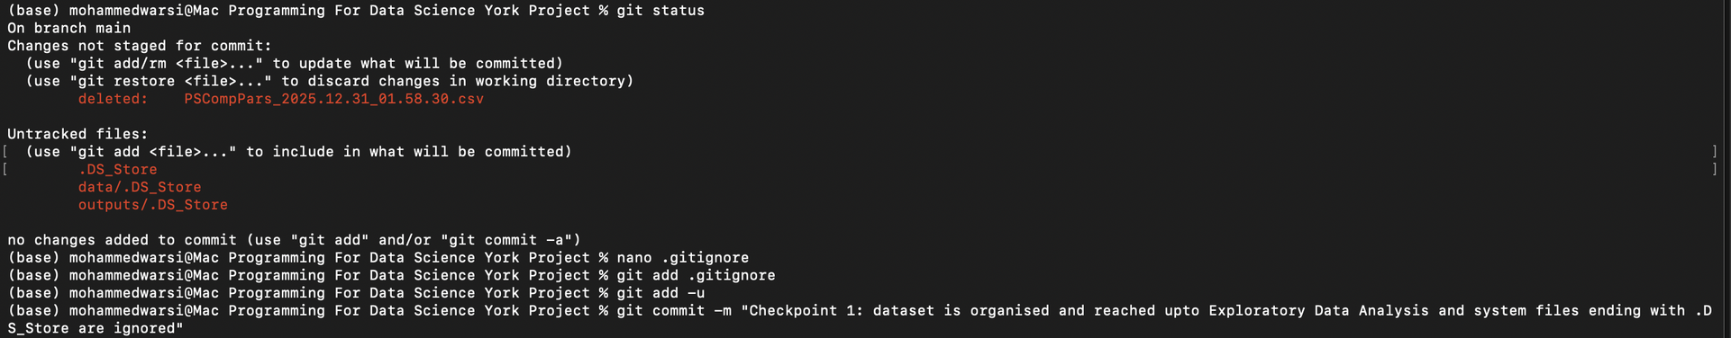
Challenges with the Code
When loading the dataset into python, I ran into an error where the original dataset by NASA consists of comments using #, for which I used this code to combat that hurdle.
While reorganising files, bash exposed macOS system files being stored ending in .DS_Store. I used .gitignore to remove unwanted system artefacts so as to not cause further error down the line.
Notes:
Explain why macOS stores .DS_Store files and what they are

